Slide 1
Emotion and Motivation
Chapter 10

Slide 2
Agenda
Intrinsic and Extrinsic Rewards
Theories of Motivation
Hunger and Eating
Sexuality and Gender Identity
Emotion

Slide 3
What is the difference between intrinsic and extrinsic?

Slide 4
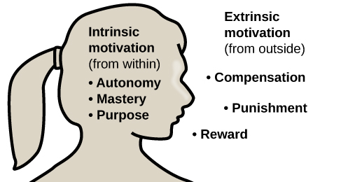
Intrinsic and Extrinsic Rewards
What is an example of an extrinsic reward?
What is an example of an intrinsic reward?
Notes:
intrinsic (arising from internal factors) – baking for friends because you enjoy watching them smile
extrinsic (arising from external factors) – mowing someone’s yard for cash

Slide 5
Theories of Motivation

Slide 6
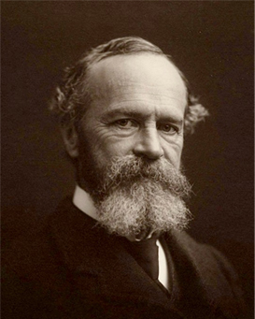
The Instinct Theory of Motivation
William James
Notes:
instinct is a species-specific pattern of behavior that is not learned
James theorized that behavior was driven by a number of instincts, which aid survival
-ignores the role of learning

Slide 7

The Drive Theory of Motivation
Notes:
-According to the drive theory of motivation, deviations from homeostasis create physiological needs. These needs result in psychological drive states that direct behavior to meet the need and, ultimately, bring the system back to homeostasis.
-Homeostasis is the tendency to maintain a balance, or optimal level, within a biological system
-Interestingly, drive theory also emphasizes the role that habits play in the type of behavioral response in which we engage. -A habit is a pattern of behavior in which we regularly engage. Once we have engaged in a behavior that successfully reduces a drive, we are more likely to engage in that behavior whenever faced with that drive in the future
Ex: yearn for rest during the busiest part of the semester, yearn for something to do when bored

Slide 8
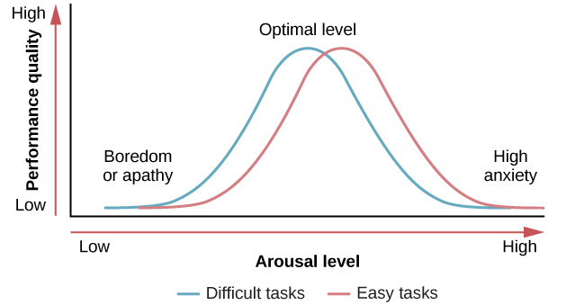
The Arousal Theory of Motivation
Yerkes-Dodson Law
Notes:
-Variation of the Drive Theory of Motivation is the Arousal Theory of Motivation
-people are driven towards behaviors, activities, and situations that will help them maintain optimal levels of arousal
the Yerkes-Dodson law, which holds that a simple task is performed best when arousal levels are relatively high and complex tasks are best performed when arousal levels are lower

Slide 9
Self-Efficacy and Social Motives
How does your confidence in your ability to do something impact your drive to do the task?
How might social motives impact your decisions and behavior?
Notes:
-Albert Bandura (1994) theorized that an individual’s sense of self-efficacy plays a pivotal role in motivating behavior
-Self-efficacy is an individual’s belief in their own capability to complete a task,
-It is the need for achievement that drives accomplishment and performance. The need for affiliation encourages positive interactions with others, and the need for intimacy causes us to seek deep, meaningful relationships.

Slide 10
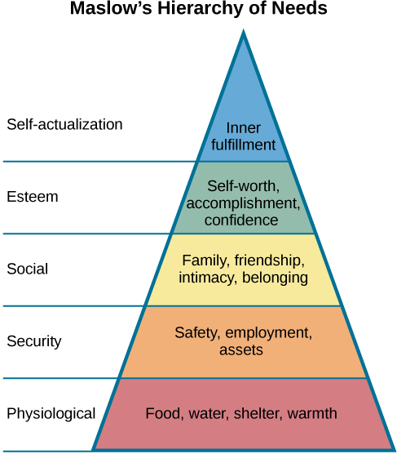
Maslow’s Hierarchy of Needs

Slide 11
Class Activity
Break into groups of 2
As a group, decide what level of Maslow’s hierarchy each character has reached/ is working on meeting

Slide 12
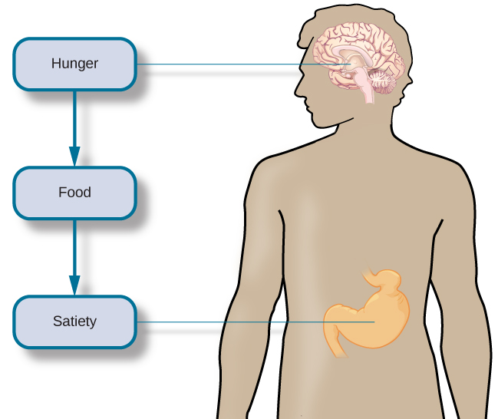
Hunger and Eating
How do you know when to eat? Or when to stop eating?
Blood glucose
Satiation
Leptin
Metabolic rate
Set-point theory
Notes:
-When our stomachs are empty, they contract. Typically, a person then experiences hunger pangs. Chemical messages travel to the brain, and serve as a signal to initiate feeding behavior. When our blood glucose levels drop, the pancreas and liver generate a number of chemical signals that induce hunger
-satiation- the feeling of fullness and satisfaction; when we have eaten enough, fat cells release leptin, a satiety hormone; additionally, blood glucose increases, and the pancreas and liver send a message to stop eating
-metabolic rate is the amount of energy that is expended in a given period of time (there is tremendous individual variability in our metabolic rates)
-The set-point theory asserts that each individual has an ideal body weight, or set point, which is resistant to change (Note: not all research aligns with set point theory

Slide 13
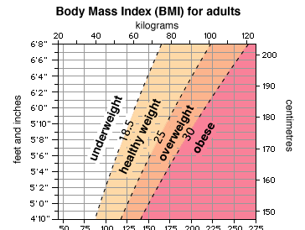
Obesity
Overweight vs obesity vs severe obesity
Is BMI a good tool for measuring physical health?
Notes:
Overweight – BMI between 25 and 29.9
Obesity – BMI over 30
Severe Obesity – BMI over 30
BMI over-generalizes, making it a poor indicator of health

Slide 14
Eating & Image Disorders
Anorexia nervosa – an obsessive disorder where an individual will severely restrict their food intake
Bulimia – a disorder characterized by cycles of binge eating and purging
Purging can include vomiting, laxative abuse, extreme dieting/ fasting, and substance abuse
Binge-eating – a disorder characterized by excessive eating, often to the point of feeling sick
Body dysmorphic disorder – a preoccupation with a perceived defect in one’s physical appearance
Excessive exercise – a health-compromising behavior where an individual feels the compulsory need to exercise, to the point of damaging one’s self
Notes:
-About half of the people diagnosed with anorexia are also diagnosed with bulimia
-excessive exercise isn’t in the DSM-V yet, but is growing in public awareness

Slide 15
True or False: Sexual orientation and gender identity are the same thing.
Notes:
False
Sexual orientation – a person’ emotional, romantic, and/or erotic attraction toward other people or no people (It’s about OTHER PEOPLE)
Gender identity refers to one’s sense of being male, female, neither of these, both of these, or another gender (It’s about one’s self)

Slide 16
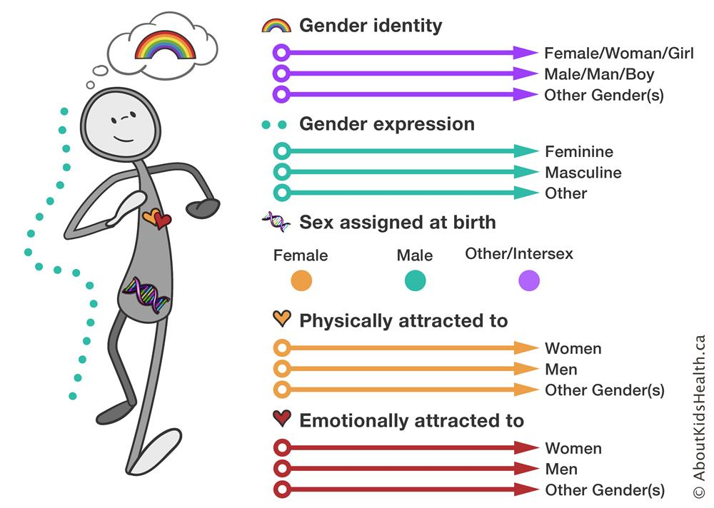
Notes:
Intersex is a general term used to describe people whose sex traits, reproductive anatomy, hormones, or chromosomes are different from the usual two ways human bodies develop. Some intersex traits are recognized at birth, while others are not recognizable until puberty or later in life
Intersex and transgender are not interchangeable terms; many transgender people have no intersex traits, and many intersex people do not consider themselves transgender.

Slide 17

Sexual Orientation
Lesbian – a woman who is attracted to other women
Gay – a man who is attracted to other men
Bisexual – a person who is attracted to men and women
Pansexual – a person who is attracted to people regardless of physical gender
Asexual – a person who is not sexually attracted to other people
Aromantic– a person who is not romantically attracted to other people
Heterosexual – a person who is attracted to people of the opposite gender
Queer – an umbrella term for a person who identifies as LGTBQ
Transgender – a person who identifies as a different gender than the sex they were assigned at birth
Trans man – a person who was assigned female at birth, but identifies as a man
Trans woman – a person who was assigned male at birth, but identifies as a female
Intersex – a person whose reproductive organs, hormones, or chromosomes contain aspects of both sexes
Notes:
-research has consistently demonstrated that the family backgrounds and experiences are very similar among straight people and LGBTQ people
-some researchers estimating that genes account for at least half of the variability seen in human sexual orientation
-Other studies report differences in brain structure and function among those with different sexual orientations
-evolutionary psychologist would argue that it is a response to the size of the population, matching other animal species that can change gender
-others believe it’s a normal part of animal behavior, as other species participate in same-sex socio-sexual behaviors (ex: beluga whales)

Slide 18
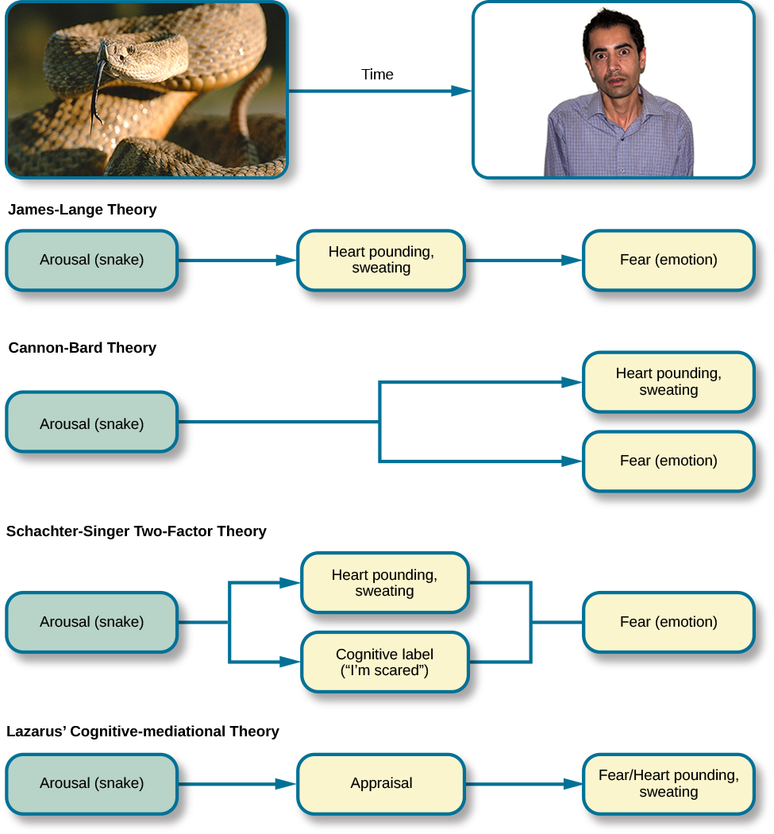
Emotion Theories
Notes:
James-Lange theory of emotion asserts that emotions arise from physiological arousal (you would only experience a feeling of fear after this physiological arousal had taken place)
Cannon-Bard theory-physiological arousal and emotional experience occur simultaneously, yet independently (too many emotions that are not driven specific arousals)
Schachter-Singer two-factor theory -emotions are composed of two factors: physiological and cognitive; physiological arousal is interpreted in context to produce the emotional experience.
cognitive-mediational theory that asserts our emotions are determined by our appraisal of the stimulus

Slide 19
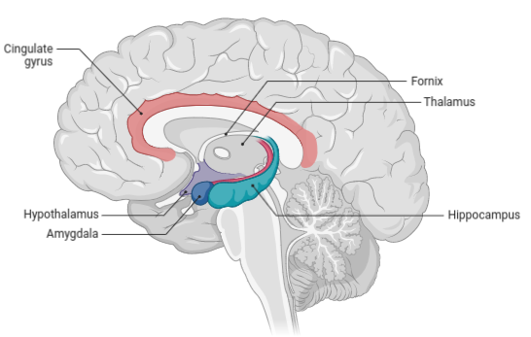
The Biology of Emotions
Hypothalamus – involved in activation of the sympathetic nervous system (part of an emotional reaction).
Thalamus – sensory relay center, neurons project to both the amygdala and higher cortical regions for further processing.
Amygdala – plays a role in processing emotional information and sending it on to cortical structures.
Hippocampus – integrates emotional experience with cognition.
Notes:
The limbic system includes the hypothalamus, thalamus, amygdala, and the hippocampus.

Slide 20

Demonstrating Emotions
Cultural display rule
The seven universal emotions
Body Language
Facial feedback hypothesis
NOT REPLICATABLE!
Notes:
Cultural display rule – culturally specific standards that govern the types and frequencies of displays of emotions that are acceptable.
Individuals from the U.S. express negative emotions like fear, anger and disgust both alone and in the presence of others.
Individuals from Japan only express these emotions while alone.
-The seven universal emotions: happiness, surprise, sadness, fright, disgust, contempt, and anger
-Body language is the expression of emotion in terms of body position or movement (60-90% of communication is non-verbal)

Slide 21
Next time on PSY 203…
BEFORE NEXT CLASS:
NEXT CLASS:
Complete Exam 3 Reflection
Read Chapter 14 & take the quiz
Chapter 14 – Stress, Lifestyle, and Health

